Slide 1

About me!
Krystie heschke

Slide 2

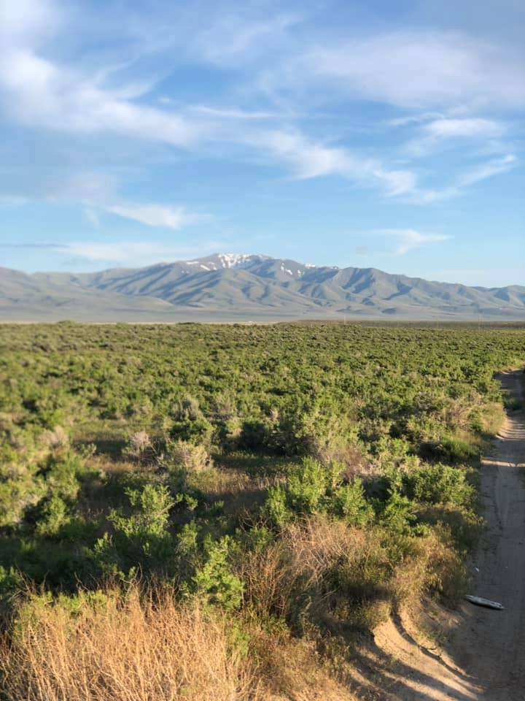
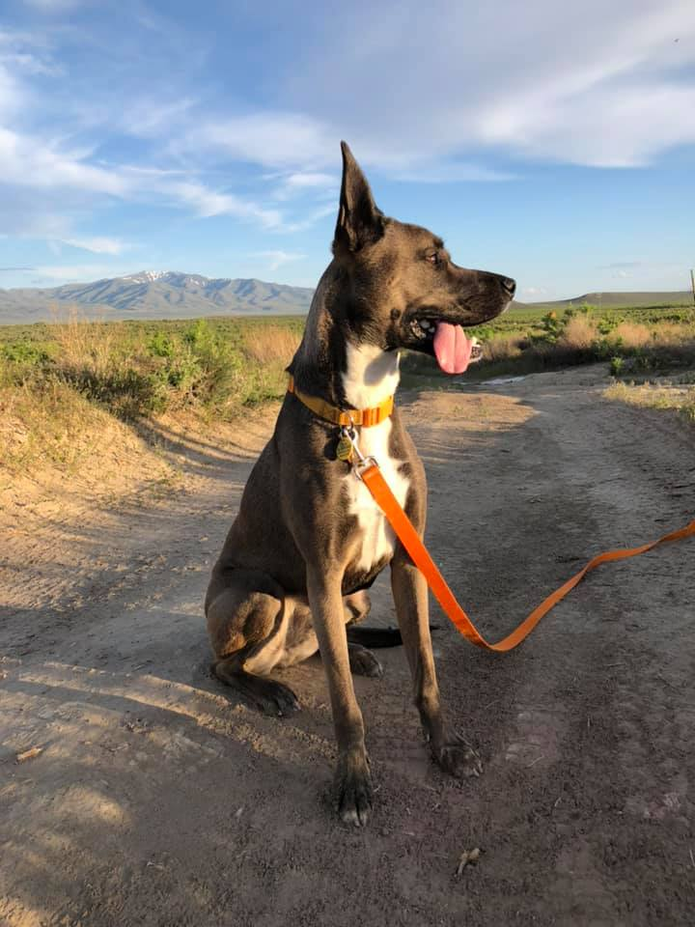
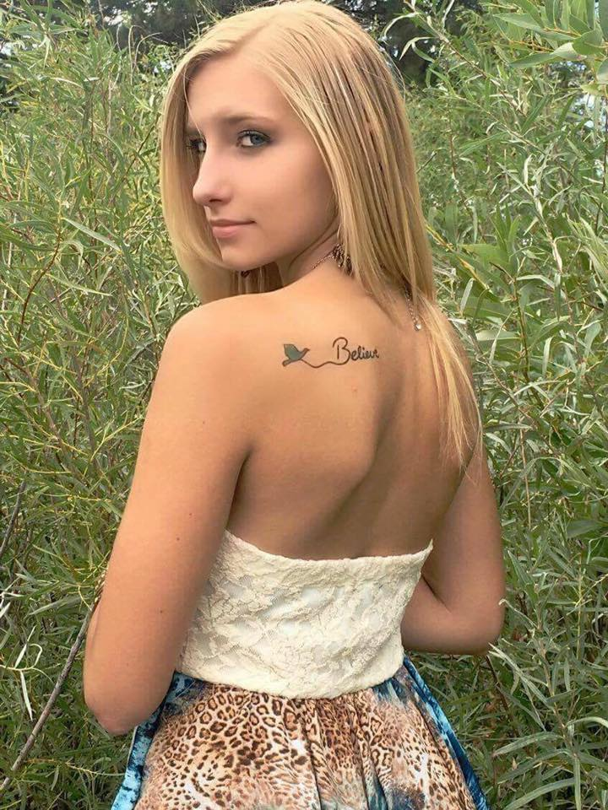
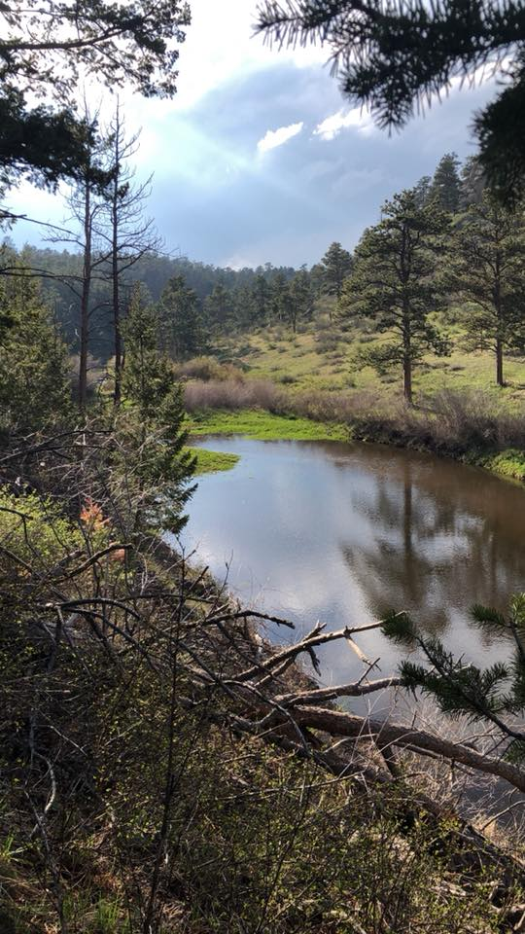
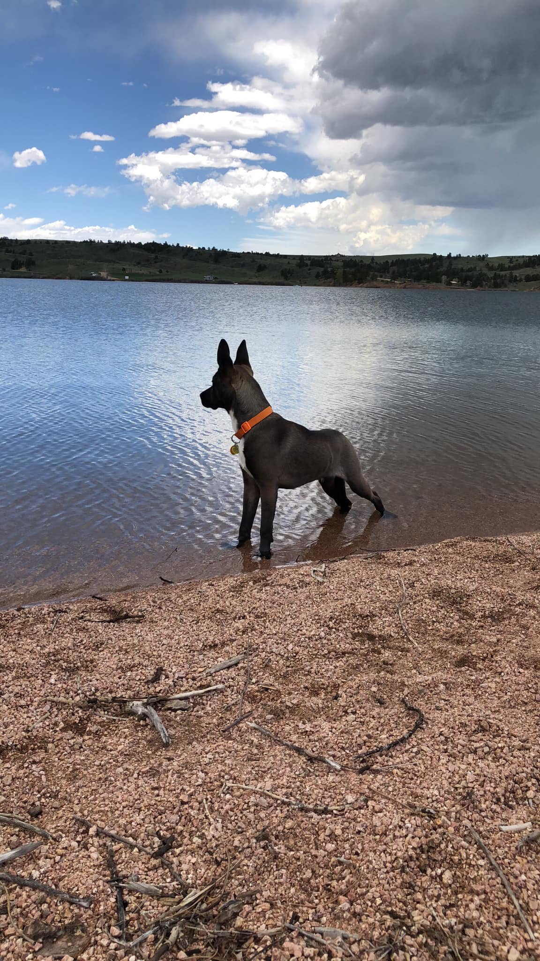
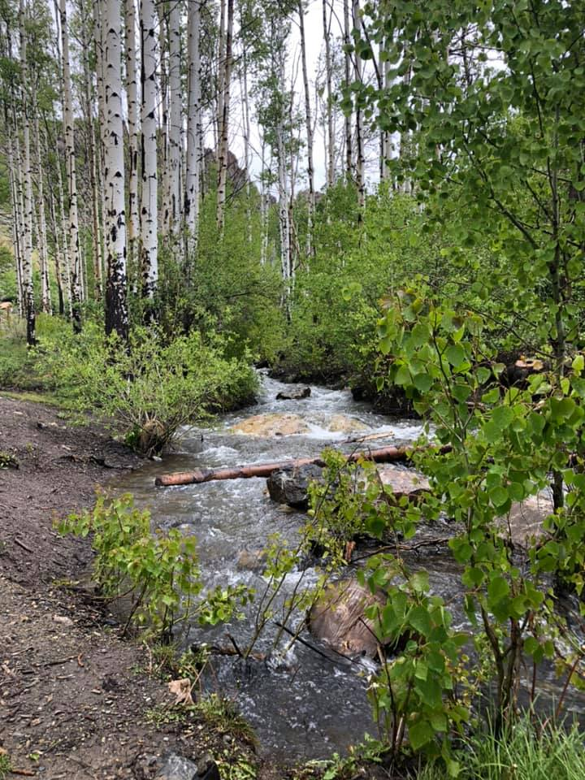
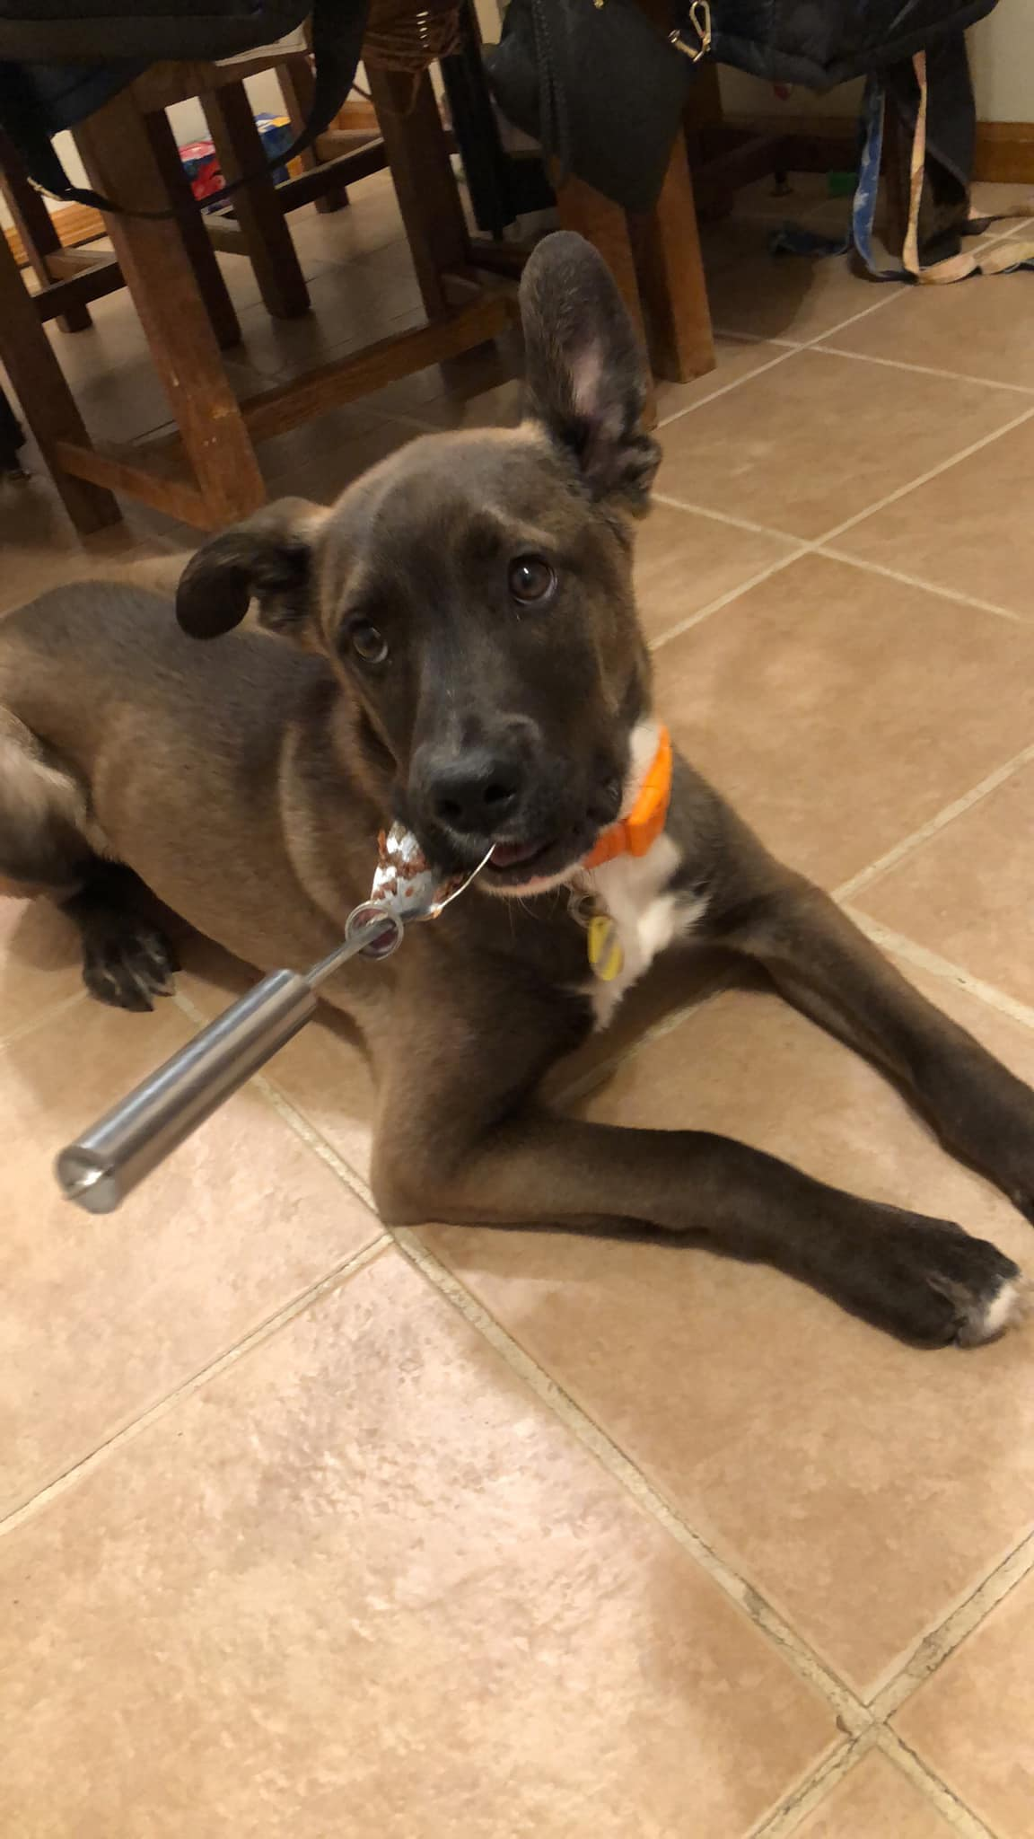
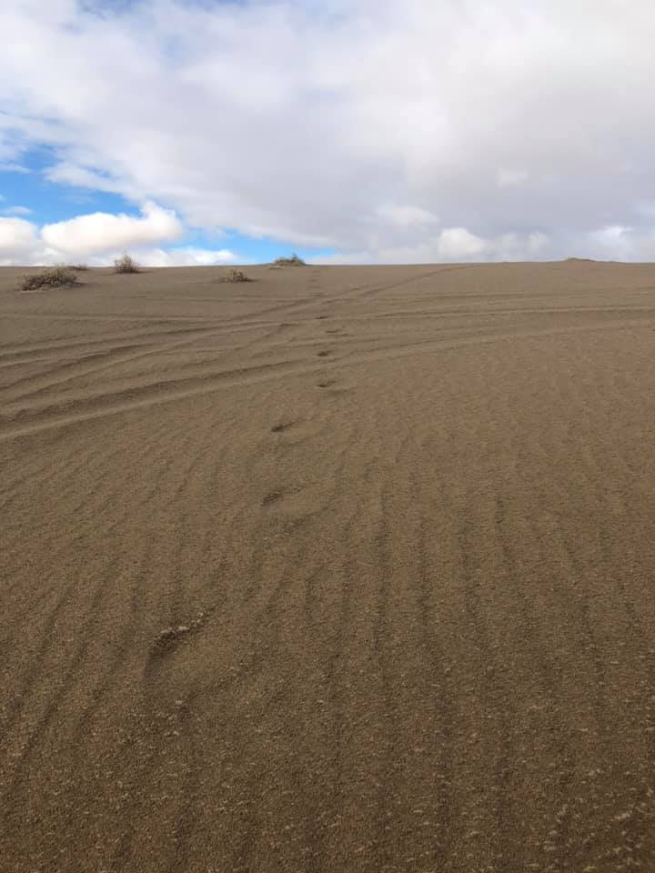
A Little bit about me

Slide 3

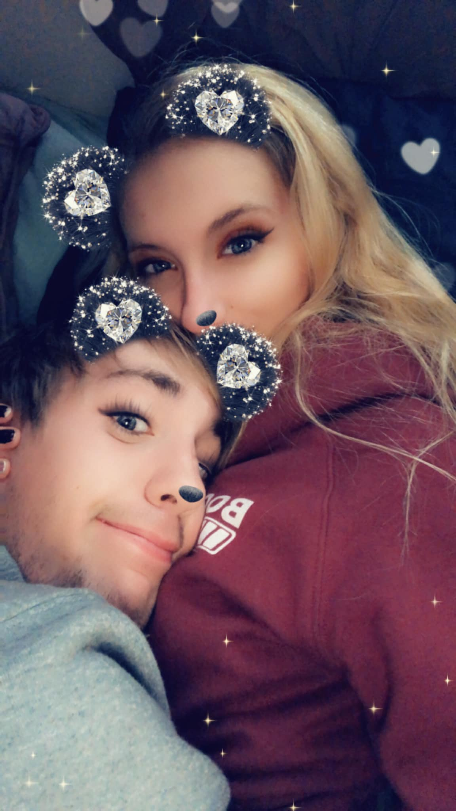
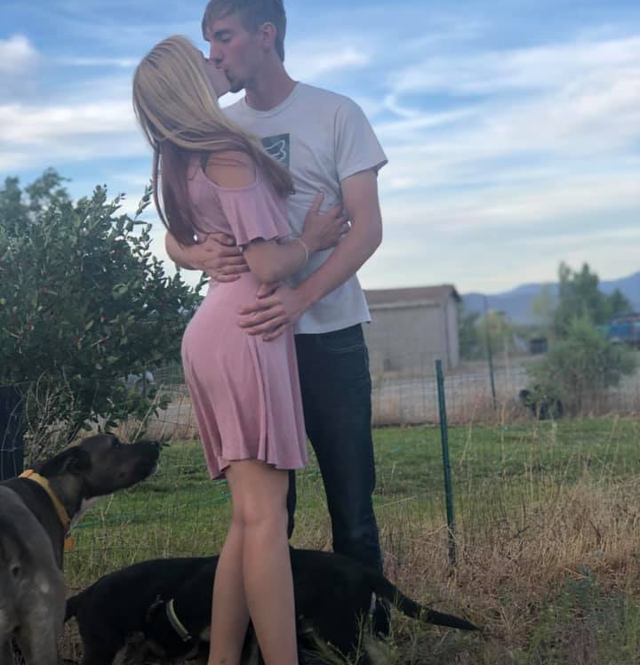
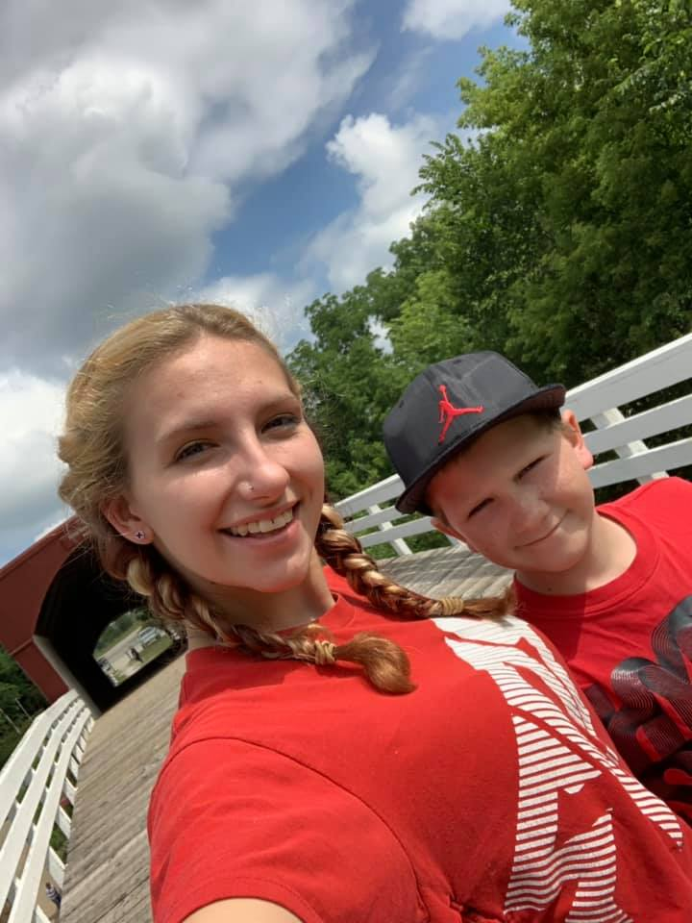
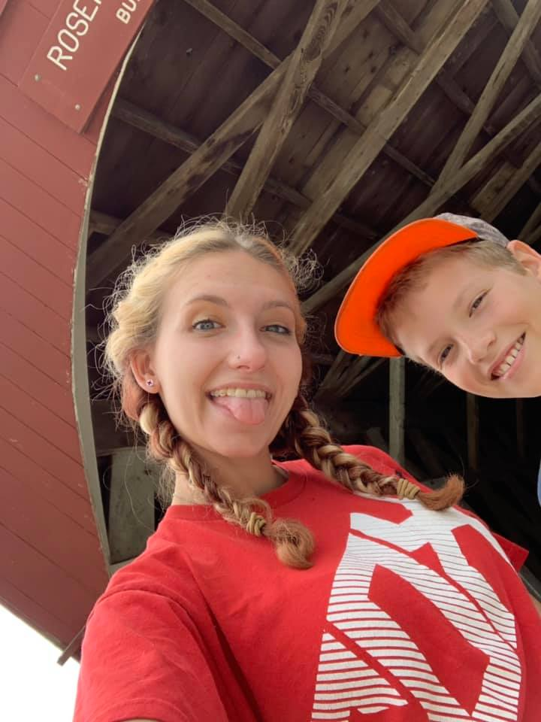
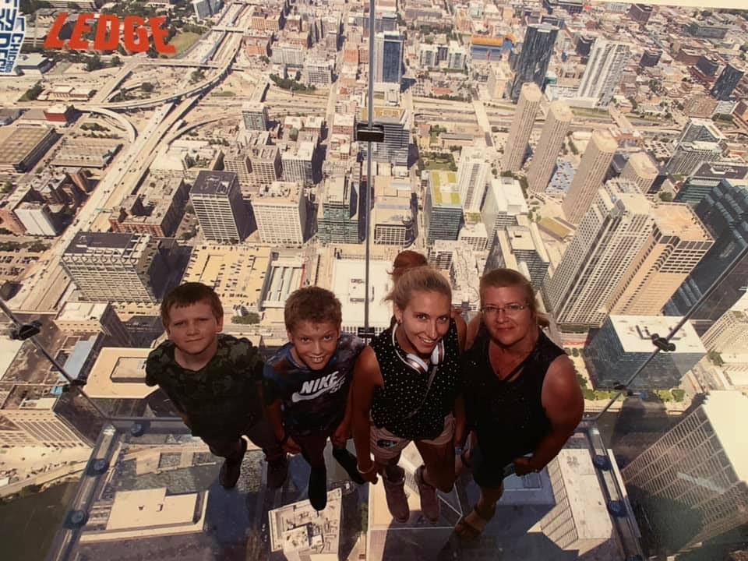
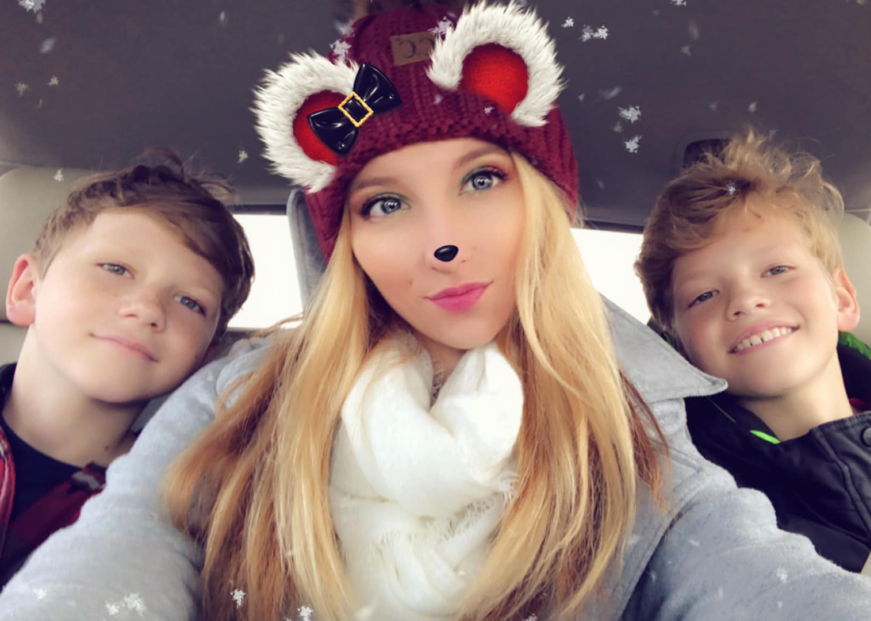
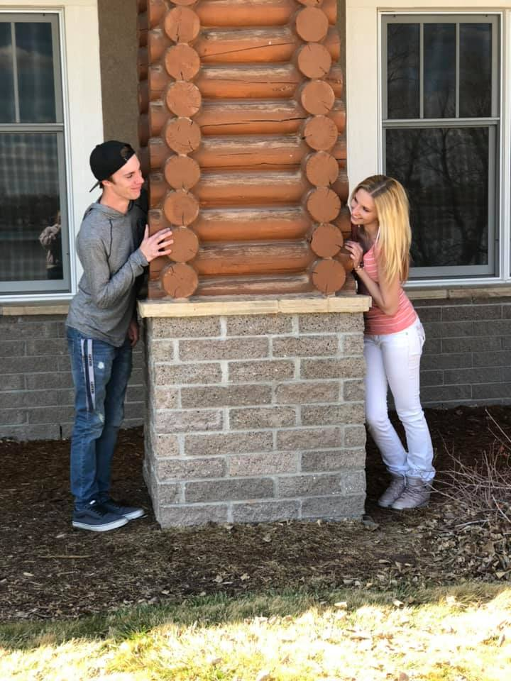
My Family

Slide 4
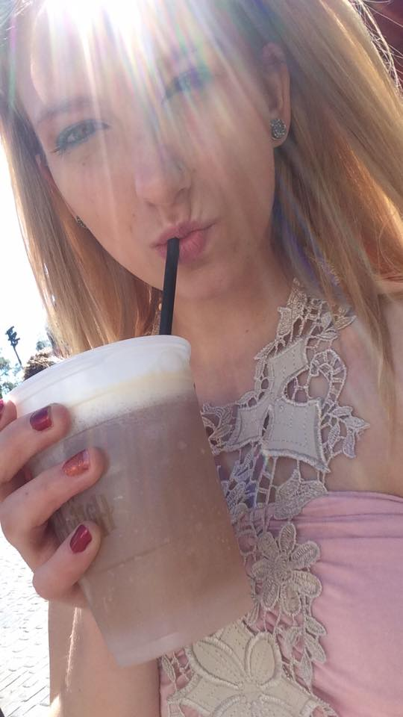
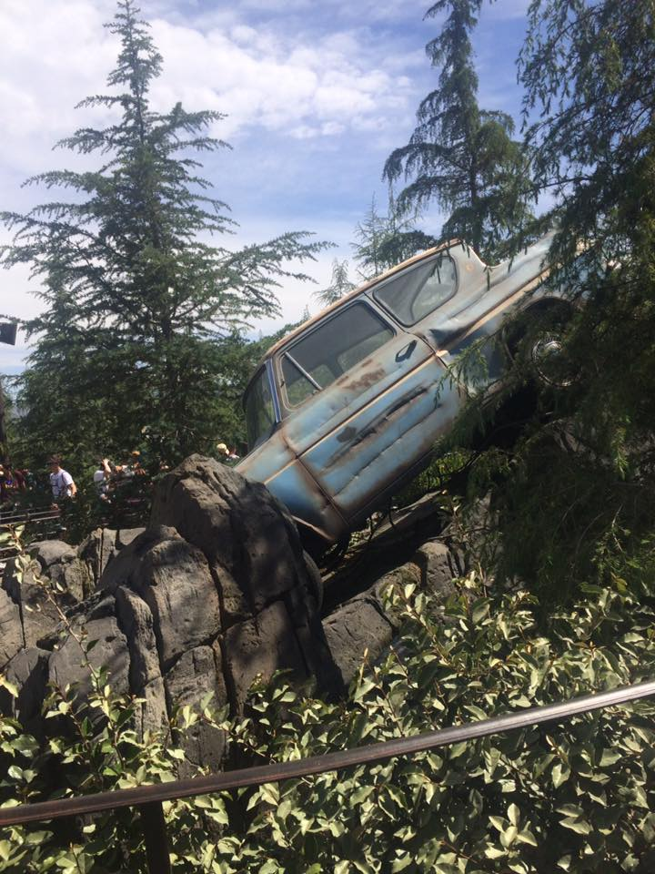
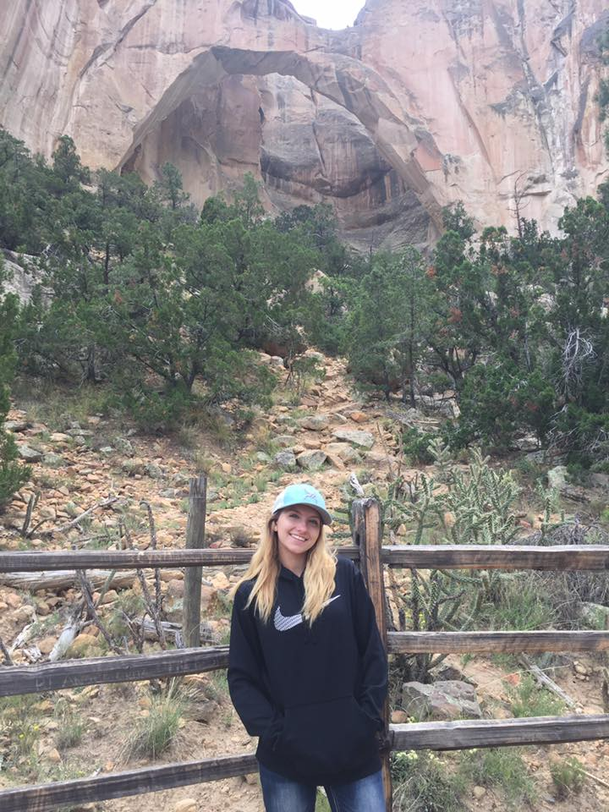
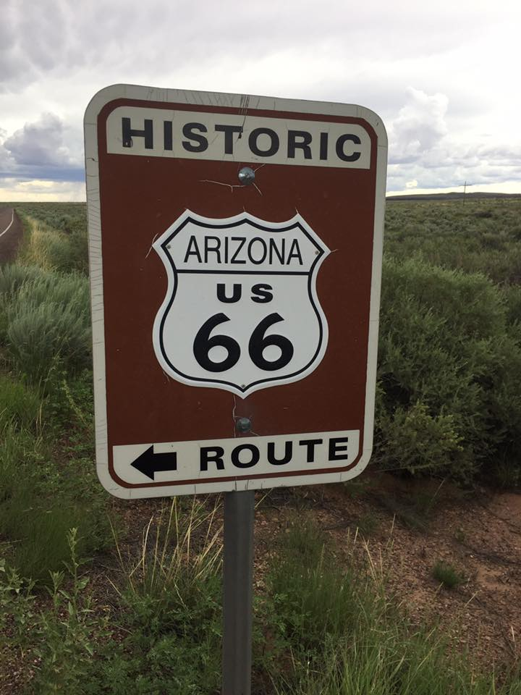
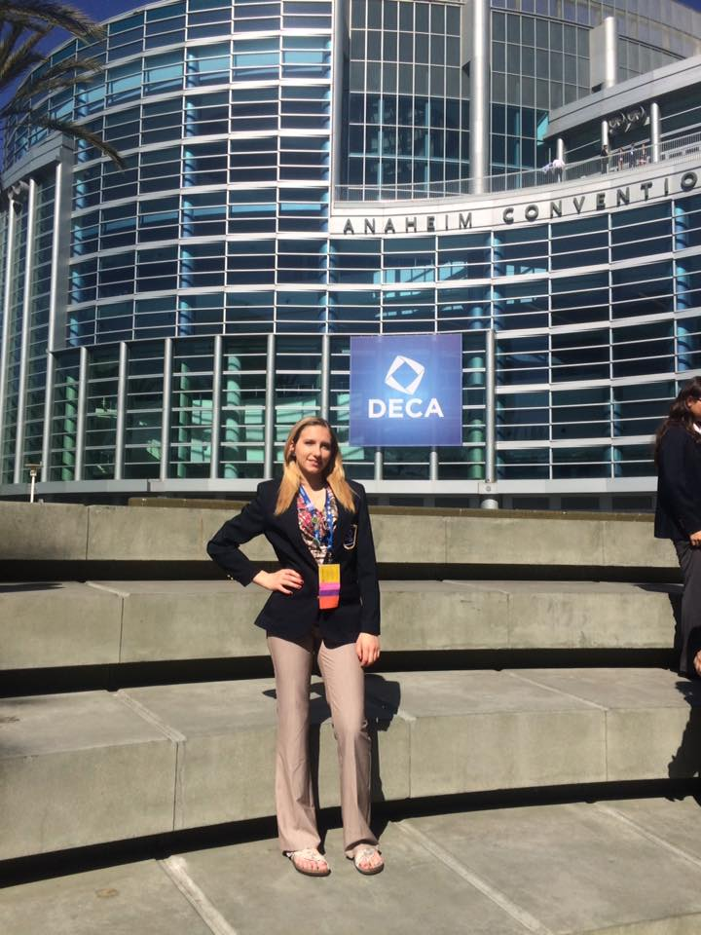
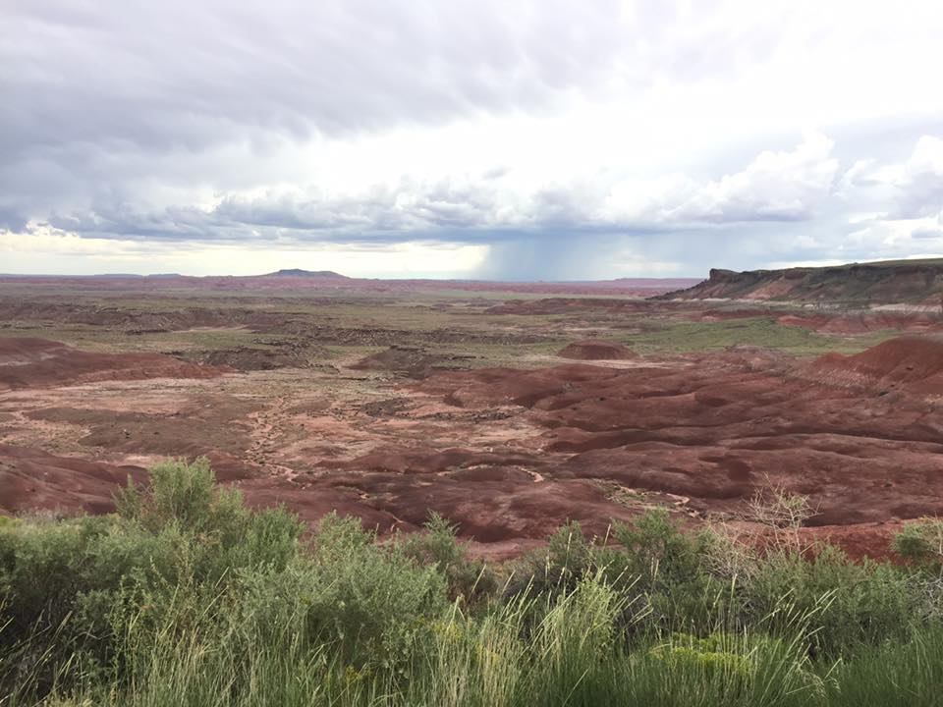
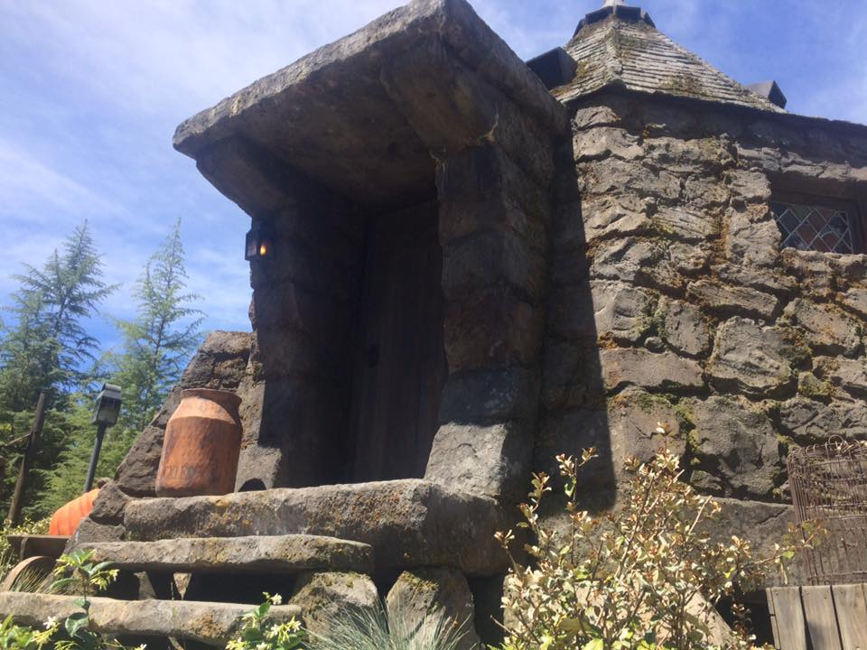
A little bit more

Slide 5
Academic goals
To get my batchers in Business finance with a minor in marketing through UW
Finish my associates this year

Slide 6
Professional goals
Find a job in marketing/ advertising so that way I’m doing what I love. If you do what you love, then you’ll never work a day in your life.

Slide 7
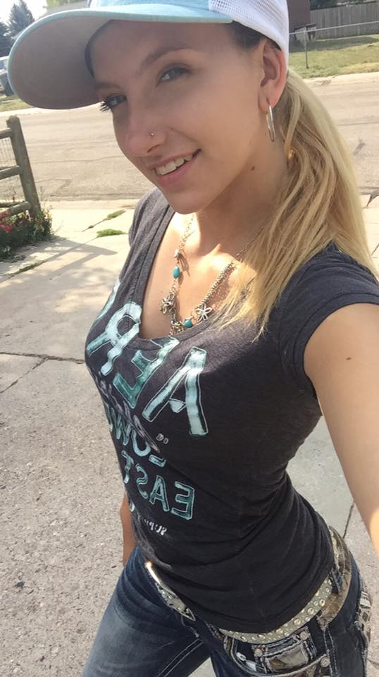
Thank you for watching!

Slide 8
references
Heschke,K . 2017. Senior photo. [photograph].
Heschke, K. 2018. Outdoors. [photograph].
Heschke, K. 2018. Outdoors. [photograph].
Heschke, K. 2017. Outdoors. [photograph].
Heschke, K. 2018. kenai. [photograph].
Heschke, K. 2018. kenai. [photograph].
Heschke, K. 2019. kenai. [photograph].
Heschke, K. 2018. Desert. [photograph].
Heschke, K. 2019. Iowa covered bridges. [photograph].
Heschke, K. 2019. Iowa covered bridges. [photograph].
Heschke, K. 2019, park. [photograph].
Heschke, K. 2019, anniversary. [photograph].
Heschke, K. 2019. Chicago. [photograph].
Heschke, K. 2018. Christmas. [photograph].
Heschke, K. 2017. universal studios. [photograph].
Heschke, K. 2017. universal studios. [photograph].
Heschke, K. 2017. universal studios. [photograph].
Heschke, K. 2017. nationals in Anaheim. [photograph].
Heschke, K.2017. Arizona. [photograph].
Heschke, K.2017. Arizona. [photograph].
Heschke, K.2017. Arizona. [photograph].
Heschke, K. 2017. Tractor pulls. [photograph].

